Slide 1
The Impact of Prices, Population, and Education:
How Real Purchasing Power differs from Nominal Income across 379 U.S. Metropolitan Areas
Alex Criollo Torres | ECO 590 | BEA & U.S. Census API | 2021 ACS 5 Year Estimated Detailed Tables

Slide 2
Research Questions & Variables
Research Questions
Key Variables
Q1
Does the regional cost of living (RPP) of a metropolitan area significantly affect its nominal median household income?
pulled Median Household Income from the Census
BEA's Regional Price Parity index to build the Real Purchasing Power
Cost_Of_Living_RPP
BEA Regional Price Parity index (national avg = 100)
Median_Household_Income
Nominal income from U.S. Census ACS 5-year
Q2
How does city size (population) affect the nominal wages of a region? How will the regional price parity change the median household income if population and level of education stay the same?
I brought in Population to test whether bigger cities simply pay more.
Real_Purchasing_Power
Income ÷ (RPP/100) — actual buying power
Education_Rate
Q3
Does the big city pay premium remain if we take into account the amount of human capital (educational attainment) in the workforce, or is the higher pay just because people who live in expensive areas tend to be more educated?
The Education Rate shows how many people in a city have a bachelor's degree or higher. I added it to see if a city-size premium is actually just an education premium.
Share of residents with a bachelor's degree or higher
Population
Total metro population (Census)
Notes:
research driven by fundamental question does living in an expensive city actually make you wealthier?
First, do higher living costs lead to higher nominal wages? .
pulled Median Household Income from the Census as my measurement. Then I used the BEA's Regional Price Parity index to build the Real Purchasing Power, which decreases the nominal income by local costs.
Second, I looked at city size. Does a bigger population directly mean higher pay?
I brought in Population to test whether bigger cities simply pay more.
Finally, i looked at whether the big city pay boost is just a result of higher education levels
The Education Rate shows how many people in a city have a bachelor's degree or higher. I added it to see if a city-size premium is actually just an education premium.

Slide 3
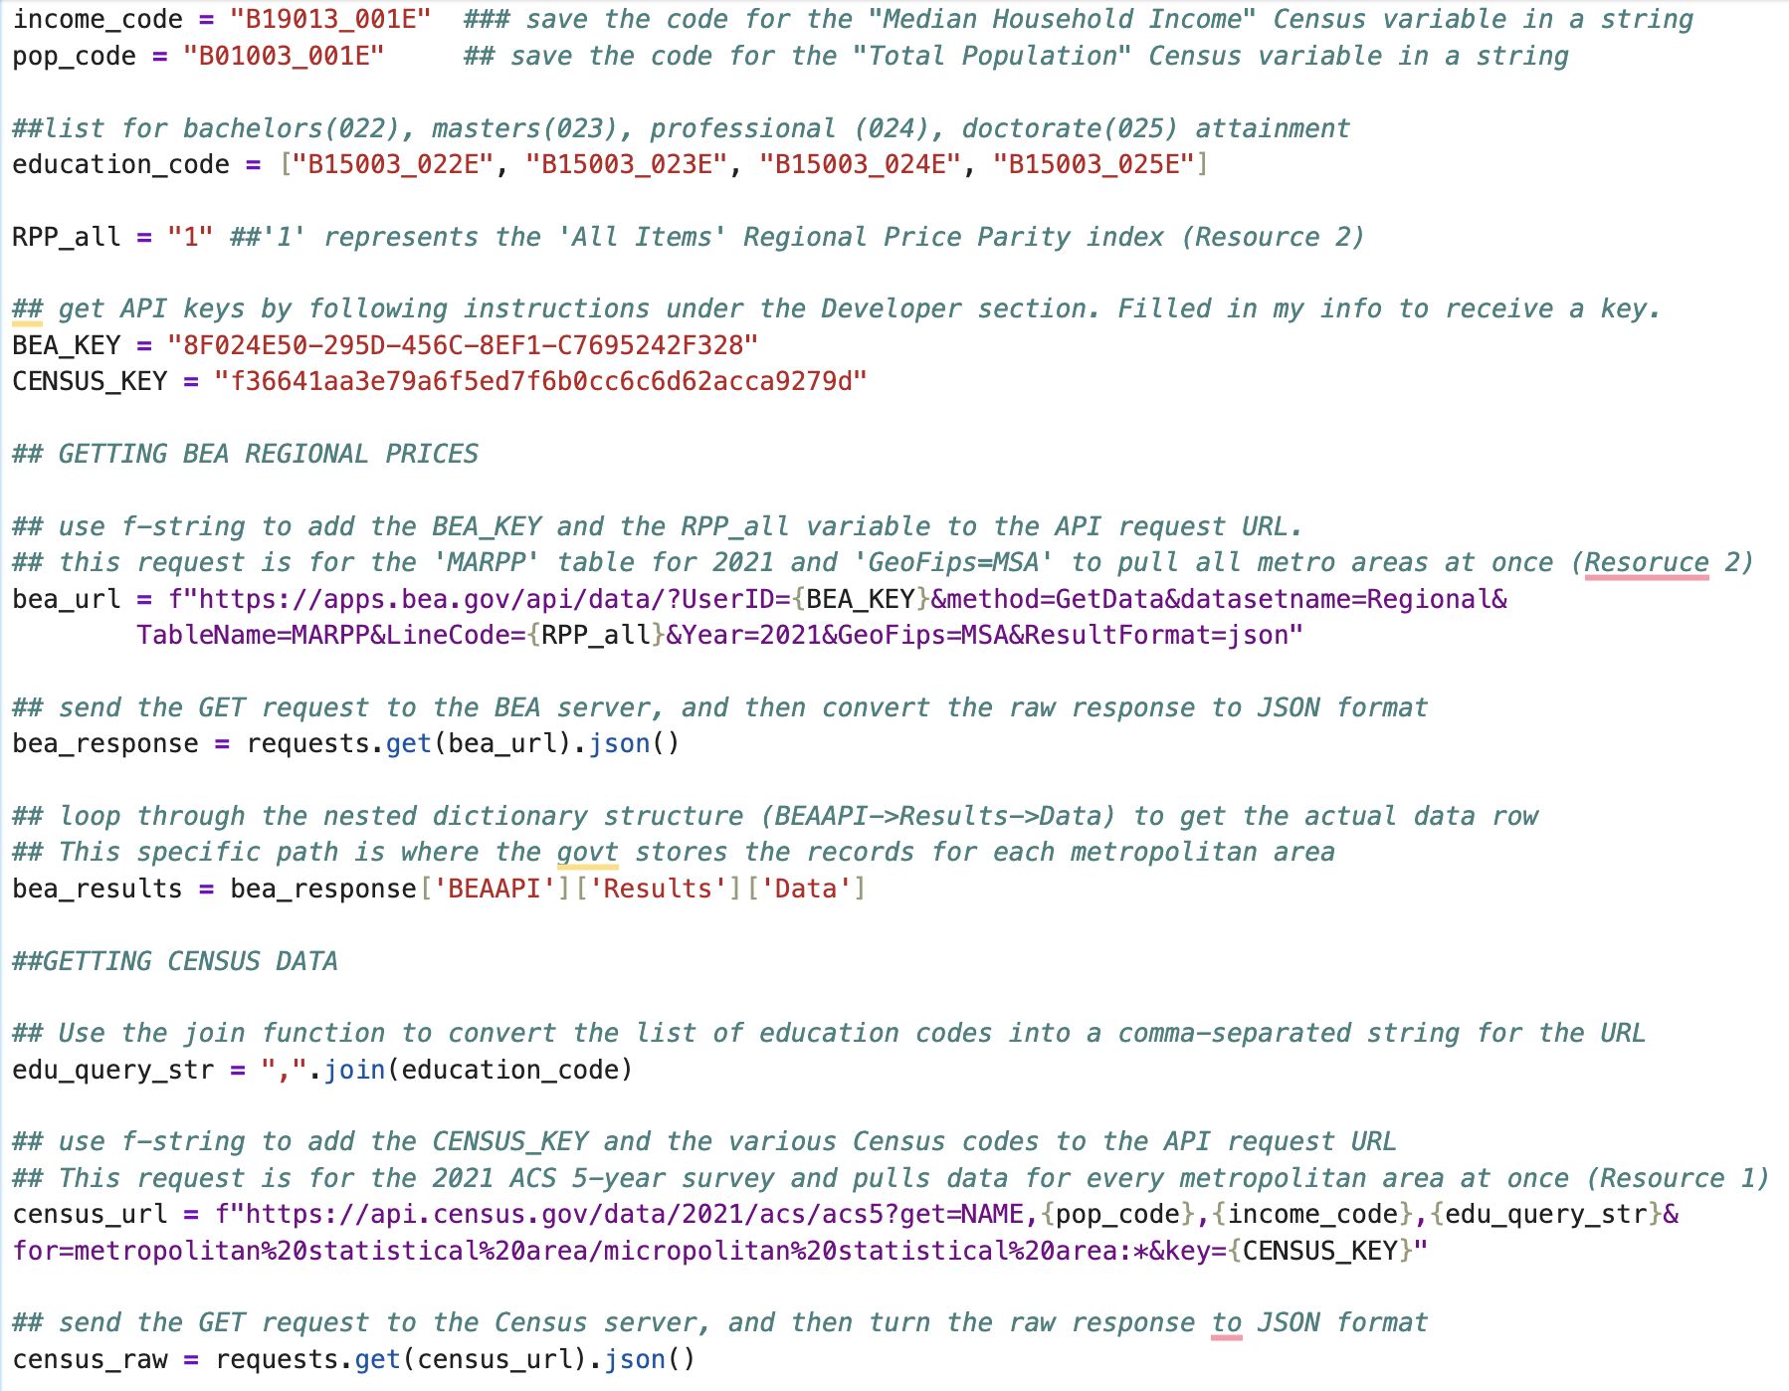
Two Government APIs
Bureau of Economic Analysis (BEA) API
The process: I used Python to request the 2021 price data directly from the BEA server.
The documentation: It was difficult to understand. The website had too many nested pages, and a basic request just gave me a mess of random numbers.
The steps taken: I had to dig through their developer manual to find that "LineCode=1" was the specific parameter needed to pull the overall cost of living.
Census API
American Community Survey (ACS 5-Year)
The process: I used Python to pull income and education data for every city at once.
How I found the data: The Census has thousands of variables, so I had to figure out which ones meant "college degrees."
The steps taken: I went online to the Census Variable Dictionary. I used the lookup function to search for "Bachelors" and "Masters," found their exact codes (like B15003), and combined them into my request.
Notes:
I pulled my data from two government APIs. I started with the BEA for price data. The documentation there was difficult to use because it was buried in nested pages. The step I took to figure it out was reading their developer manual to find that 'LineCode=1' was the only way to get the specific cost-of-living index I needed.
For the Census API, the challenge was figuring out the codes to collect. To do this, I went to the online Census variable dictionary. I used the lookup function to hunt down the specific codes for Bachelor's and Master's degrees. Once I found those exact IDs, I combined them into my Python URL to pull all the education data in one request

Slide 4
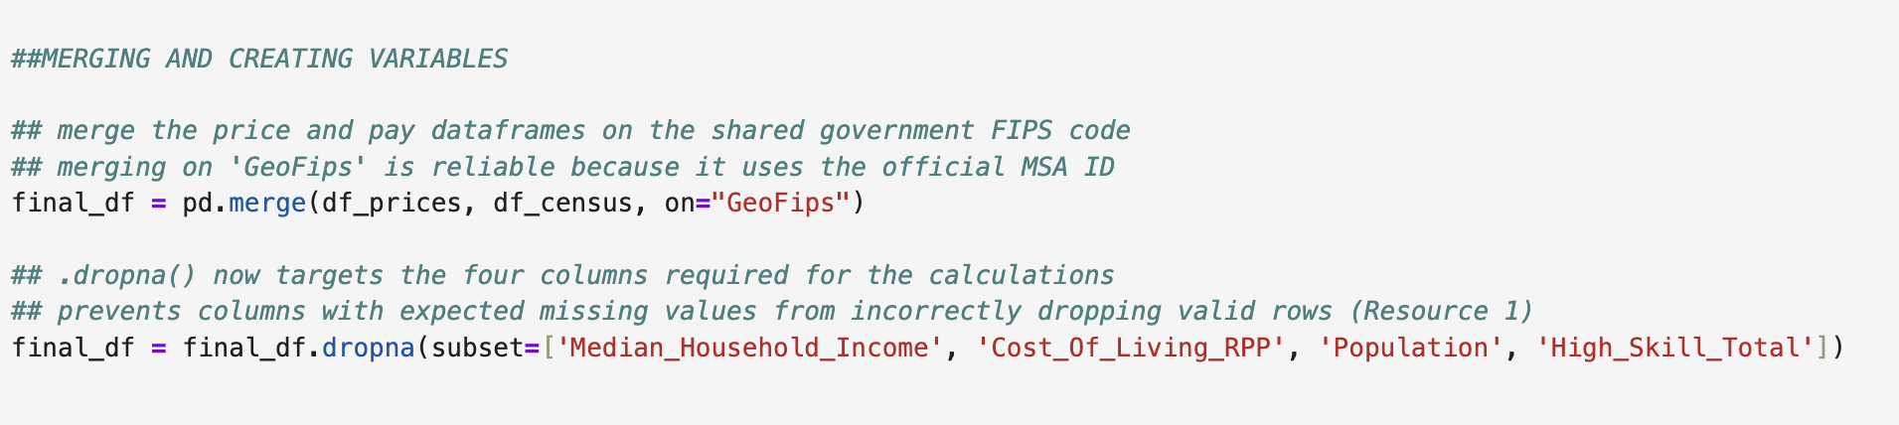
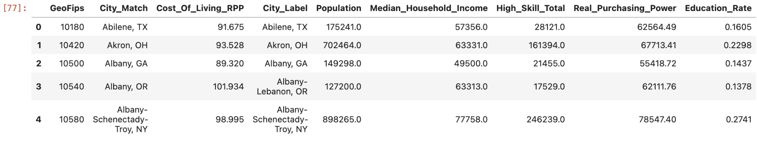
One Merged Dataset- Federal Information Processing Standard (FIPS)
The Challenge: Merging the Data
The problem:
The BEA and Census name cities differently (e.g., "New York" vs "New York City").
Past mistakes:
Matching by text row-by-row was highly inefficient and caused errors.
The Solution: The FIPS Bridge
The fix:
Both datasets use the Federal GeoFips Code—a unique ID for every city.
The result:
Successfully matched 379 cities instantly using Pandas.
Notes:
To finish describing my data collection process, I had to combine the price data and the income data into one usable dataset.
The major roadblock here was that the BEA and the Census spell city names differently. I tried to match them text-by-text using a row-by-row loop, which professor k said is inefficient
To solve this, I searched through the data table structures and found that both tag their cities with a Federal GeoFips code, which acts like a unique ID for a metro area. As you can see in my code, I abandoned city names entirely and used Pandas to merge the datasets using that FIPS code. This single line of code instantly matched 379 cities

Slide 5
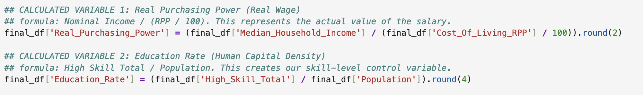
Created Variables
Real_Purchasing_Power
Education_Rate
High_Cost
Nominal Income ÷ (RPP / 100)
High_Skill_Total ÷ Population
1 if RPP > 100, else 0
Why built:
Why built:
Why built:
This variable takes a city's salary and divides it by its local price index. This shows the real cost of living, not just the nominal amount of money on a salary statement.
By dividing by population, you get a density measure that lets you compare a city of 50,000 people to one of 5 million people fairly.
A binary column that isolates the 63 expensive metro areas (RPP above the national average). Used in Regression 2 only for high-cost cities, testing if wage premium is different in expensive areas.
Ex: San Francisco pays $118k nominally but only $98k in real terms (RPP = 120) wealth.
Ex: Boulder, CO has one of the highest education rates (~0.42), meaning 42% of residents hold at least a bachelor's degree.
63 cities flagged as High Cost (RPP > 100). 316 cities flagged as Low Cost.
Notes:
couldn't answer my research questions with raw API data so I had to make three new variables.
First, Real Purchasing Power. The Census gives nominal income,so I deflated it by the BEA's price index to create a standardized dollar — so all 379 cities are compared on equal footing
Second, Education Rate. Instead of raw degree counts, I divided by population to get a density measure to test whether the big-city pay boost is really just a skill premium.
I identified the 63 cities above the national RPP average with a 1, isolating expensive metropolitan areas in Regression 2 to see if the wage premium acts differently there.

Slide 6
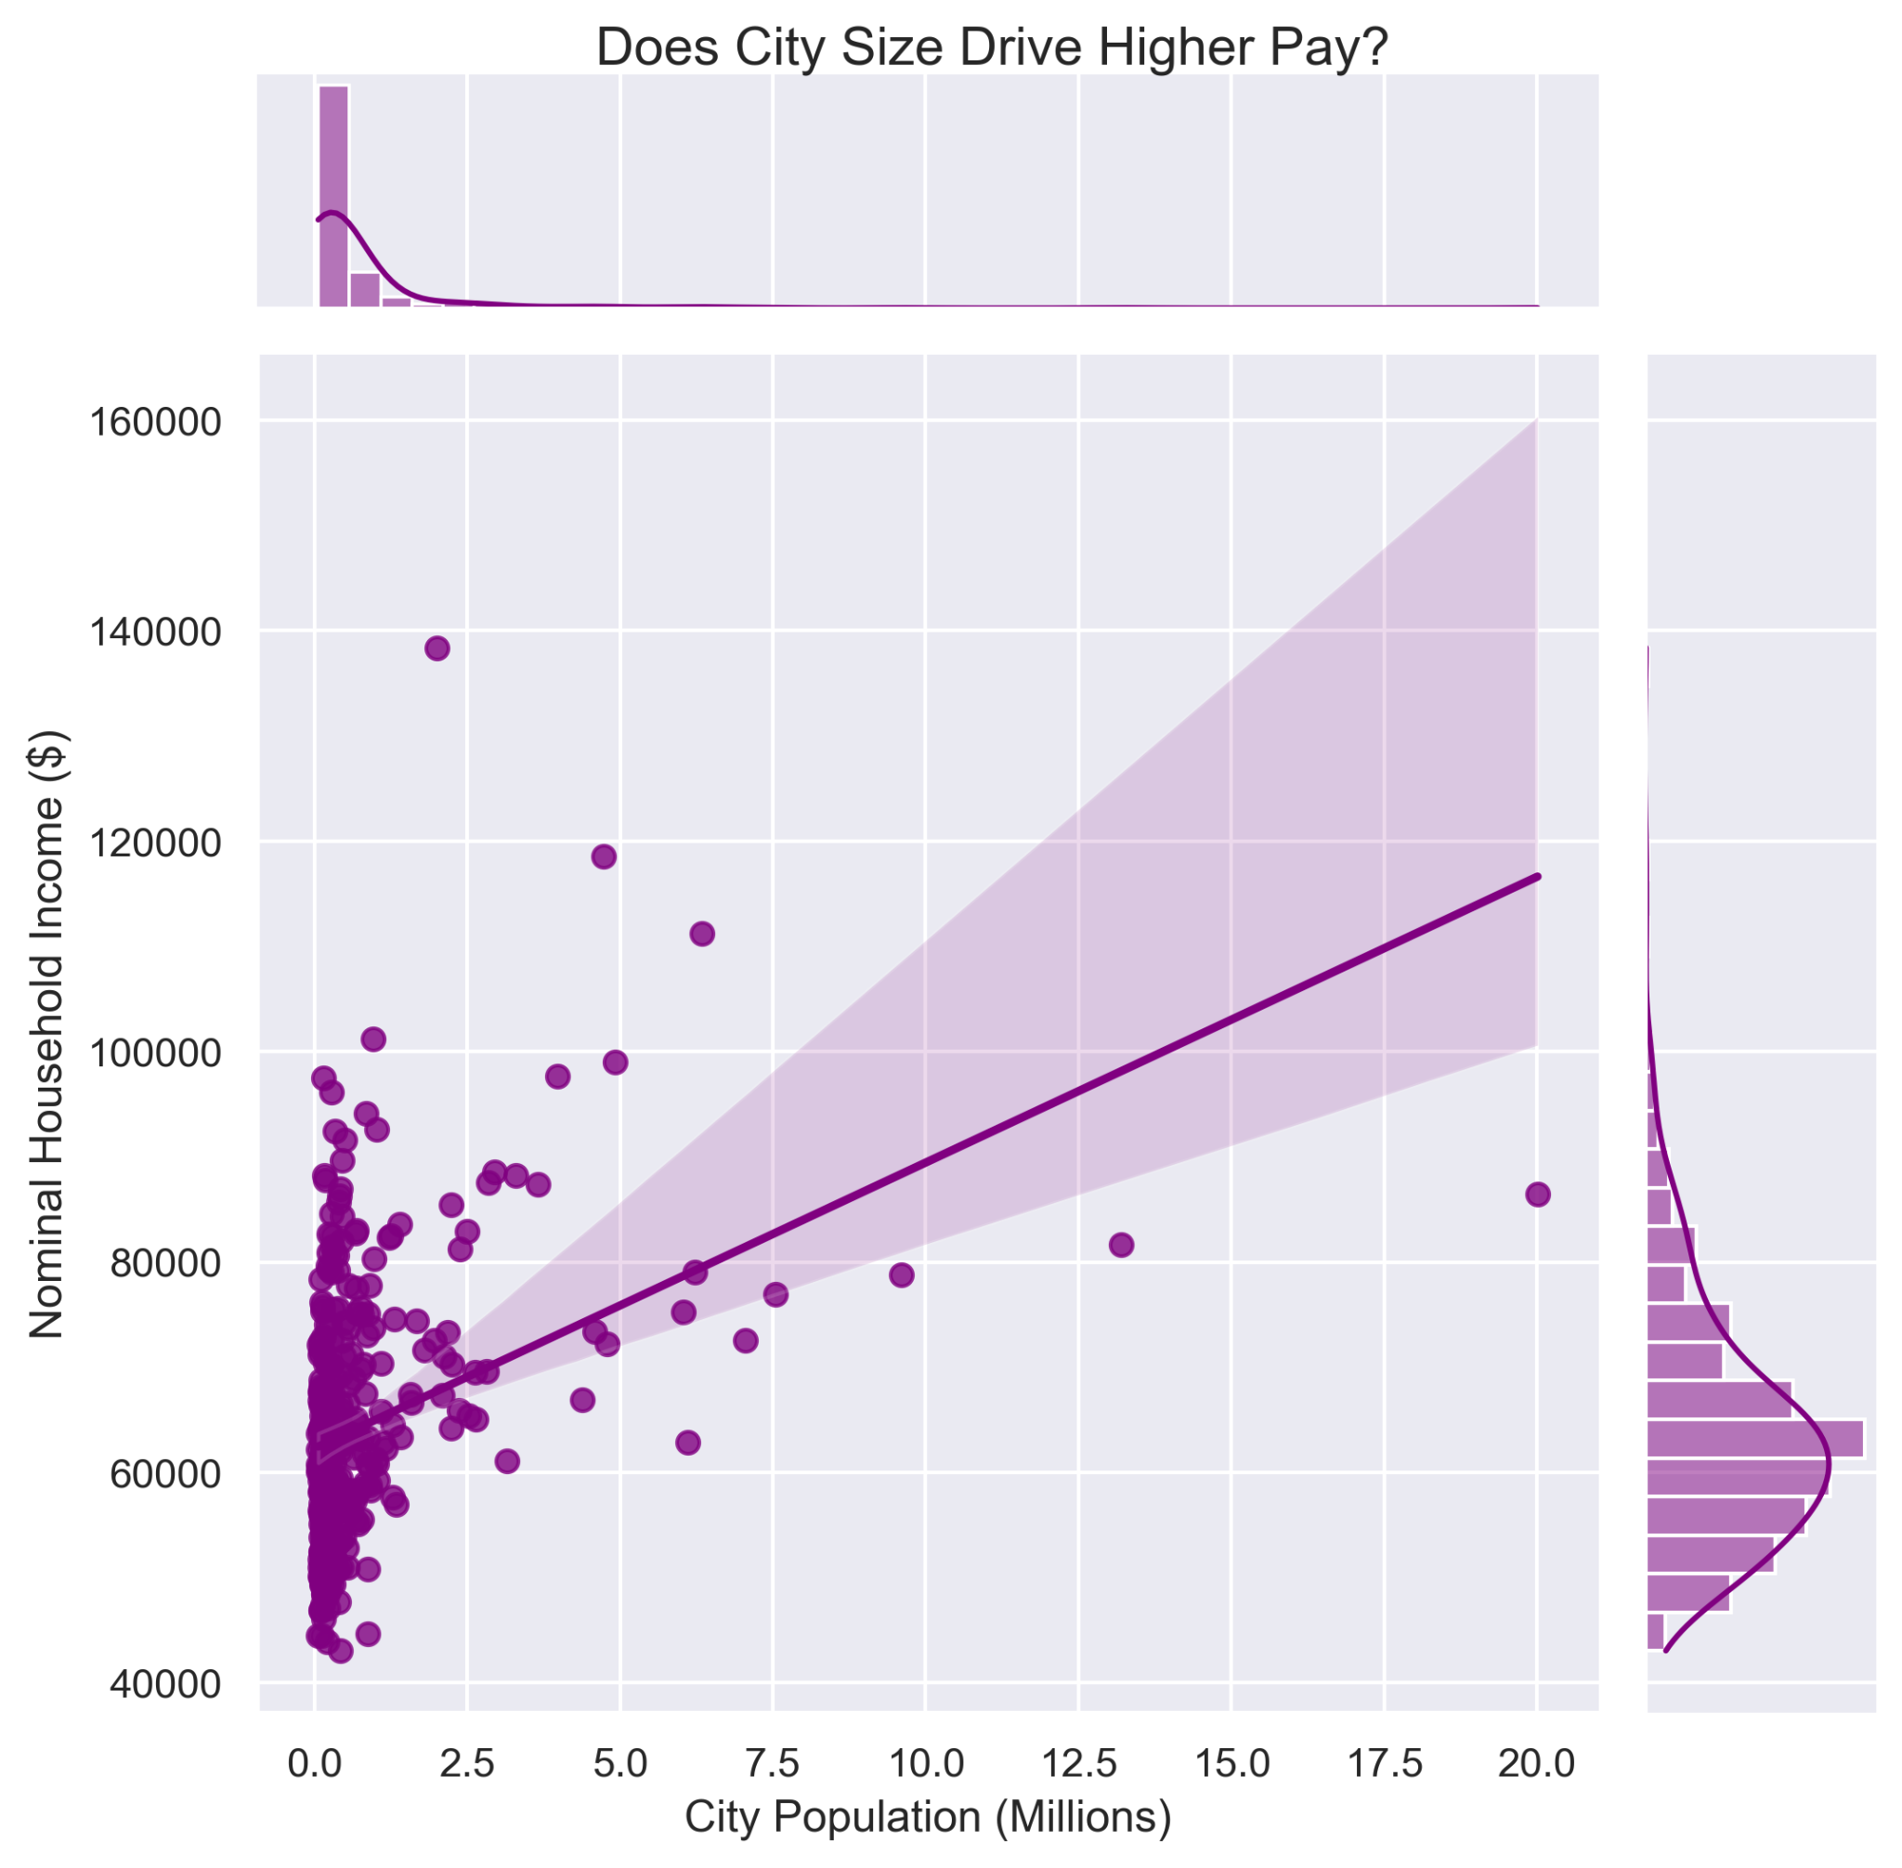
Graph 1 → Answering Research Question 2
The Finding: While the trend points upward, the massive variance and wide confidence band prove population is an unreliable predictor of wealth.
The Variance: A massive cluster of small-to-mid-sized cities (under 2.5M) swing wildly in income, proving you do not need a mega-city to hit a six-figure paycheck.
The Outlier: The 20M outlier (New York) has high nominal pay, but is matched or beaten by dozens of much smaller cities.
Notes:
This scatterplot answers Research Question 2 (does moving to a bigger city mean a higher nominal pay?)
The regression line does show a clear upward trend, from about $60,000 to $120,000, but the relationship is messy and unreliable. Notice how the confidence band flares out all the way to the right, which indicates high probability uncertainty as cities get bigger.
The most interesting thing I found is the large vertical cluster on the far left. The top histogram shows that nearly all U.S. metros are clustered below 2.5 million people. But if you look at the vertical spread of those dots, their incomes range from $40,000 all the way up to more than $130,000. This chart shows you don't need to be a big city to have a six figure median income.
And then finally over to the far right of the x-axis is one single dot that represents the 20 million people is the New York-Newark metro area. Yes, its nominal pay is high, but you can see that it is matched or exceeded by a lot of much smaller cities back on the left.

Slide 7

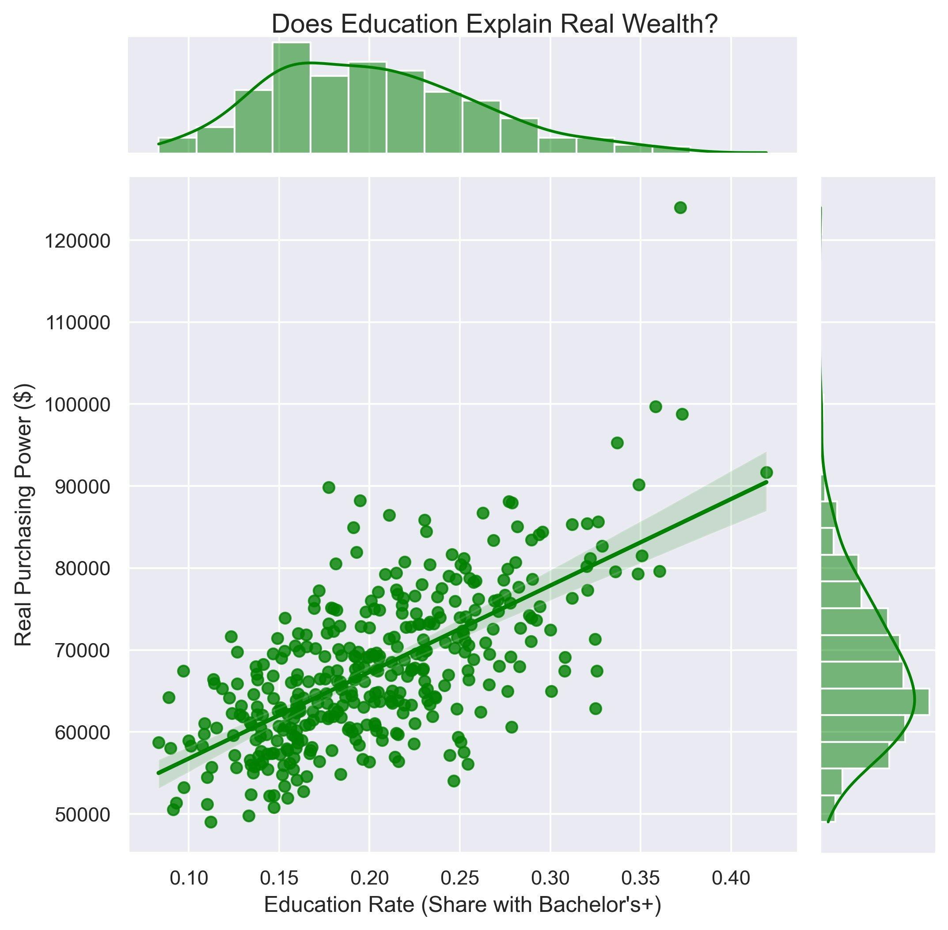
Graph 2 → Answering Research Question 3
The Slope: The steep regression line reveals a massive $35,000 swing in real purchasing power between the least and most educated cities.
The Reliability: The tight confidence band across all 379 cities confirms that human capital is a remarkably consistent and precise predictor of wealth.
The Outliers: Most cities are clustered at lower rates. Cities at 0.30+ education rates are potential outliers
Notes:
This jointplot answers Research Question 3 (does education explain real wealth)
The regression line goes from about 55,000 in real purchasing power at the low end of education, up to 90,000 at the high end. That's a 35,000 swing just from education rate alone. The confidence band is tight, which tells you that this relationship holds for all 379 cities, not just a few outliers pulling the line.
The most interesting thing I found was the top histogram. The vast majority of U.S. metropolitan areas are clustered on the left side of this chart, with between 10% and 25% with college degrees.

Slide 8
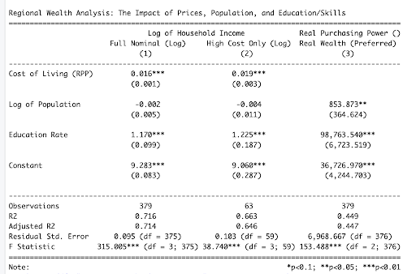
Regression Results
Preferred Model- 3
Key Interpretation:
Education Rate coefficient of 98,763 means a 0.01 rise in college-degree share is associated with a +$987 increase in Real Purchasing Power.
The Real Wage Trap
RPP effect is larger in expensive cities (+1.9% vs +1.6%), confirming that high costs consume nominal gains.
Notes:
This is the model I like best because it uses Real Purchasing Power to measure real financial stability instead of just looking at salaries and prices that seem high in some areas.

Slide 9
Conclusions
Q1: Cost of living raises nominal pay, but the gain is largely consumed by prices.
RPP is significantly positive in Models 1 & 2. Its effect is larger in expensive metros (+1.87% vs +1.64%), confirming that salaries in high-cost areas must scale just to maintain a basic standard of living.
Q2: Real wealth goes up a little with city size, but that's not the important point
Log Population is weakly significant in the preferred model (p = 0.02). NYC is a clear visual outlier; however, size alone does not explain wealth distribution across metros.
Q3: Education is the primary driver. The big-city premium is an education premium.
Education Rate coeff = 98,763: a 0.01 rise in degree-share adds ~$987 in real purchasing power (p < 0.001). Human capital is the most reliable predictor of regional wealth.

